Slide 1
DIVISION ALGORITHMS

Slide 2
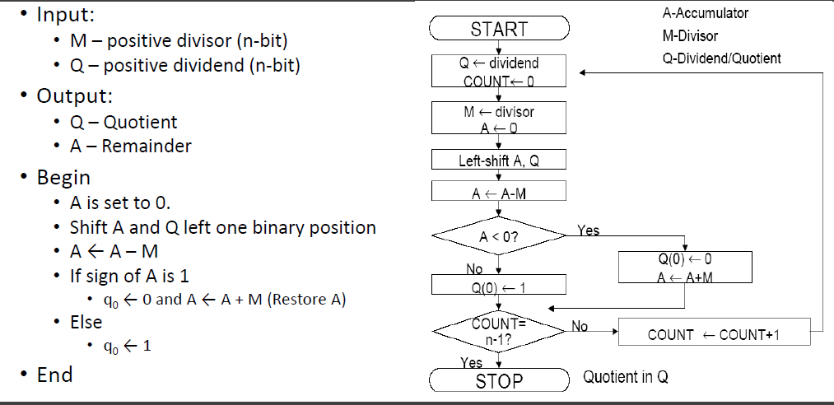
Restoring Division

Slide 3
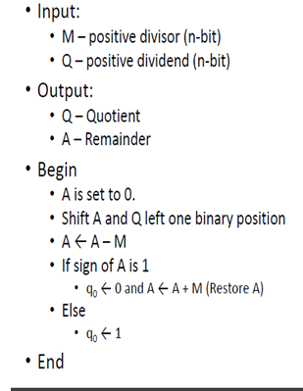
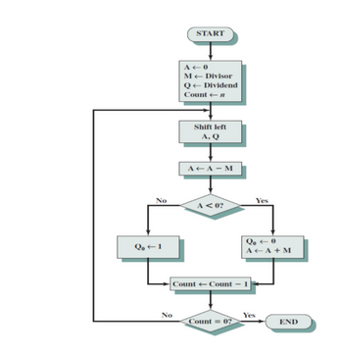
Restoring Division

Slide 4
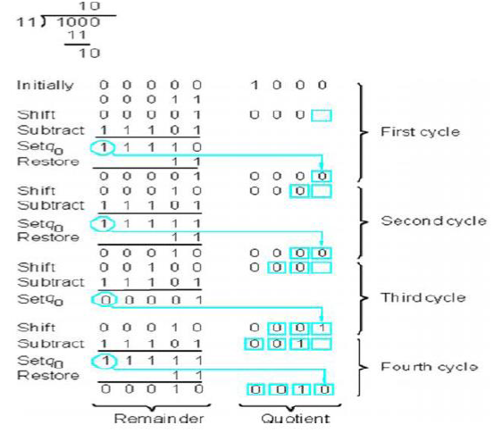

Slide 5
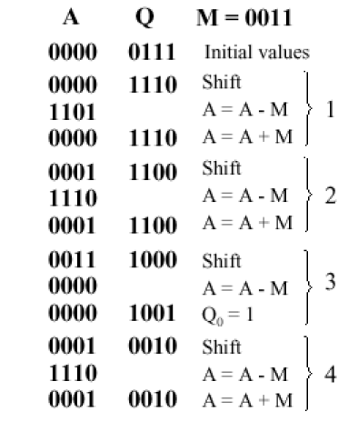
7/3

Slide 6
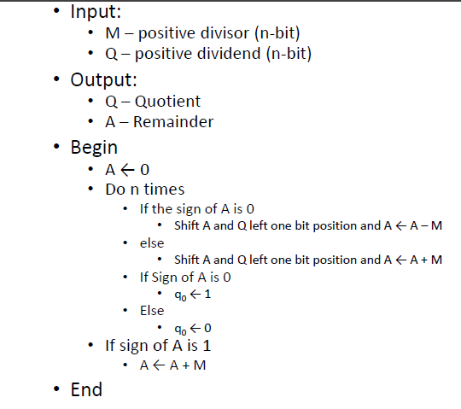
Non-Restoring Division

Slide 7
Non-restoring Division
Step-1: | Initialize registers Q = Dividend, M = Divisor, A = 0, n = number of bits in dividend
Step-2: | If sign bit of register A is 1 then shift left content of AQ and A=A+M, otherwise shift left content of AQ and A=A-M (means add 2's complement of M to A and store it to A)
Step-3: | If sign bit of register A is 1 then Q[0]=0 otherwise Q[0]=1 (Q[0] means LSB (least significant bit) of Q)
Step-4: | The value of counter n is decremented by 1
Step-5: | If value of n becomes 0 then goto next step otherwise repeat from step-2
Step-6: | If sign bit of register A is 1 then A=A+M
Step-7: | Now register Q contains Quotient value and A contains Remainder value

Slide 8
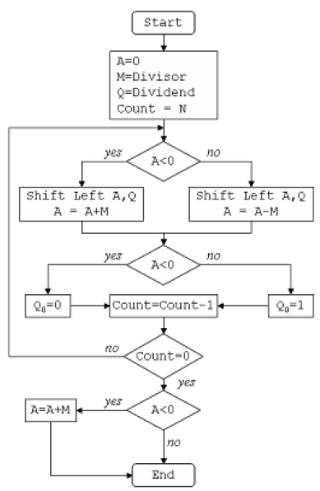

Slide 9
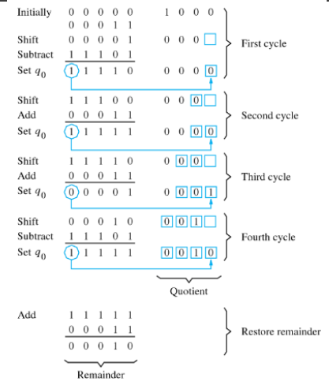
8/3

